Slide 1

Secrets Behind Academic Success
Presented by
Joshua Tean
Yan Shao
Haodong Zhang
Wilfred Andoh

Slide 2
Introduction
Yan Shao
Data were obtained in a survey of students’ performance in Math course and Portuguese Language course in two Secondary Schools in Portugal.
The purpose of the project is to use data analytic tools to reveal the relationship between students’ family socioeconomic status, students study behaviour, students’ alcohol consumption and students’ grades

Slide 3
Section 1
Overview of the Dataset
By Yan

Slide 4
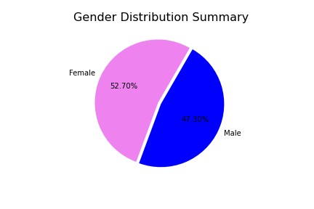
Dataset Gender Distribution Summary
The data set has a nearly equal gender distribution. There are 370 students in this survey, 52.70% of them are girls and 47.30% of them are boys.

Slide 5
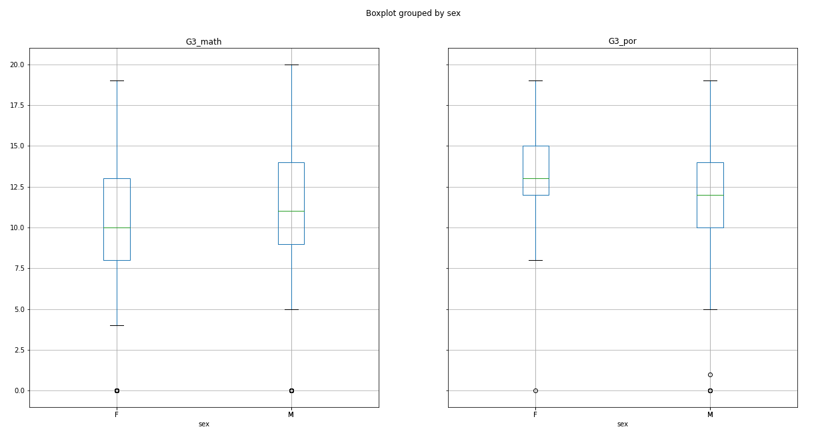
Boxplot Analysis of Final Grades vs Gender
Math
Portuguese
Notes:
1. Based on this dataset, Males performed better in Math while females performed better in Portuguese.

Slide 6
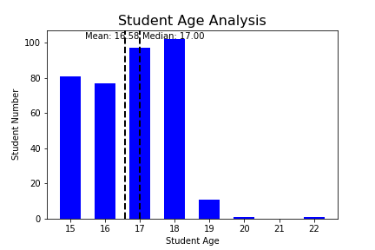
Student Age Analysis Showing Mean, Median
Notes:
From the bar chart, we could conclude that the average age of students who consume alcohol was 16.58 years old, while the median age is 17. I think, the majority of students were surprisingly young. If you don’t know, the legal age for alcohol consumption in Portugal is 18.

Slide 7
Section 2
Student Behavioural Analysis
Wilfred Andoh
Haodong Zhang

Slide 8
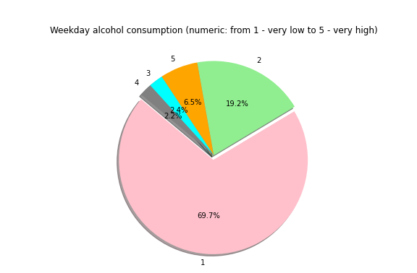
Weekday % Alcohol Consumption

Slide 9
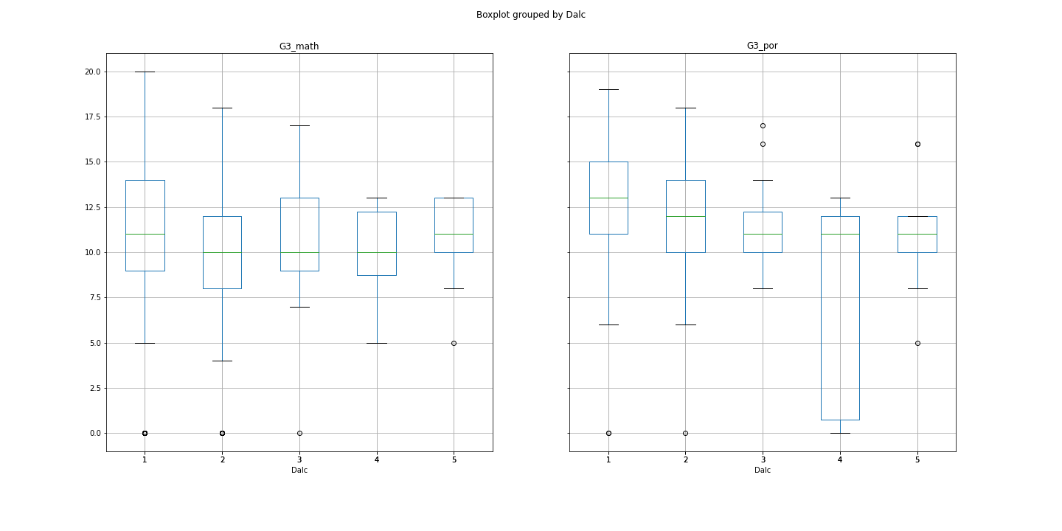
A correlation between Weekday alcohol consumers & how it affects their grades.
Math
Portuguese

Slide 10
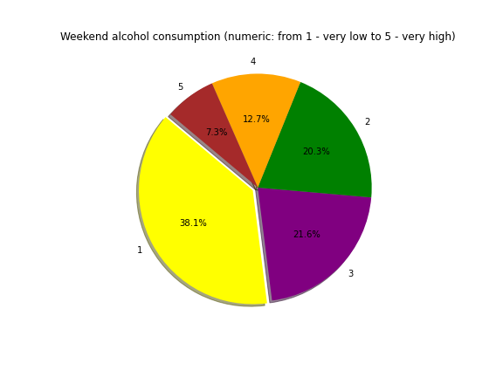
Weekend % Alcohol consumption

Slide 11
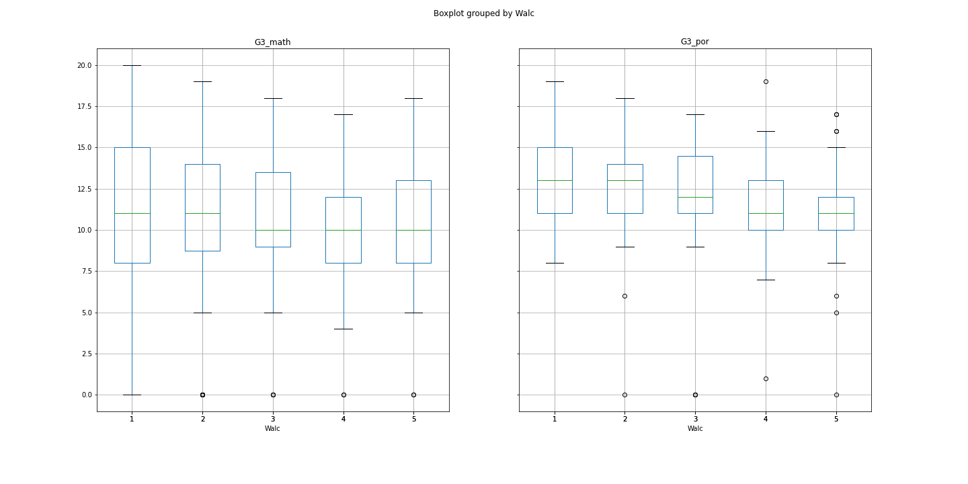
A correlation between Weekend Alcohol consumers how & it affects their grades
Math
Portuguese

Slide 12
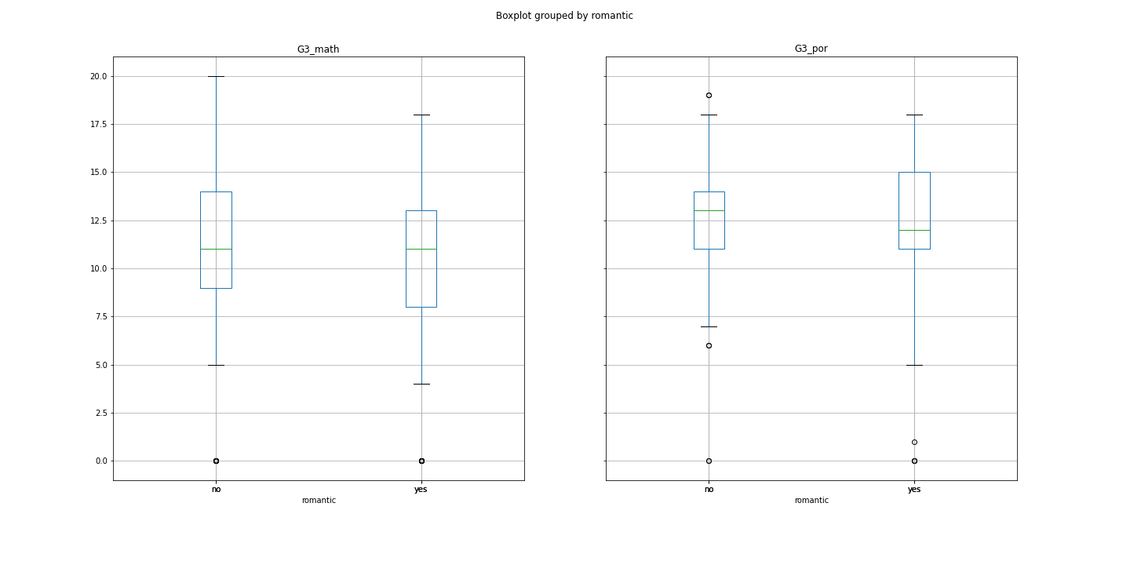

Box plot showing Relationship Status vs Final Grades
Math
Portuguese

Slide 13
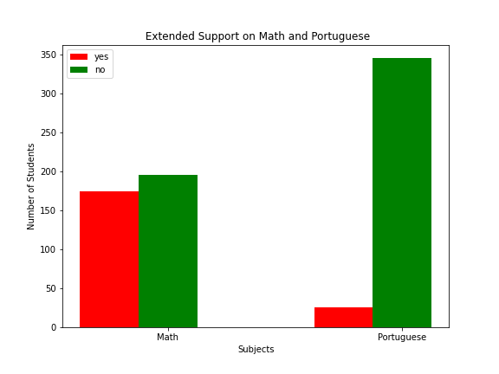
Analysis on Extended Educational Support for Math & Portuguese

Slide 14



Slide 15
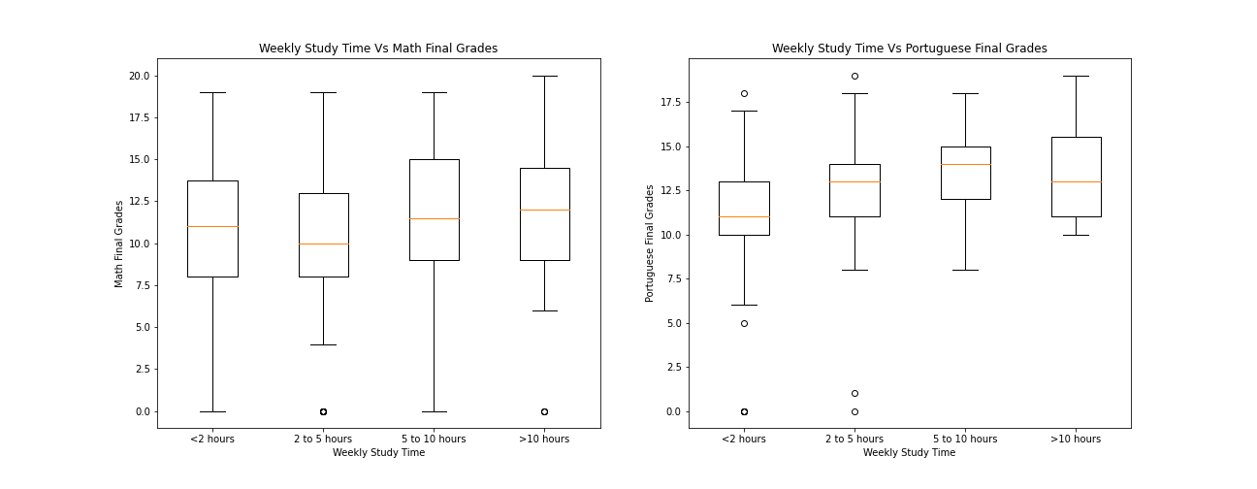
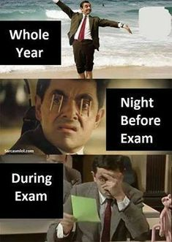
Weekly study time vs Math & Portuguese final grades

Slide 16
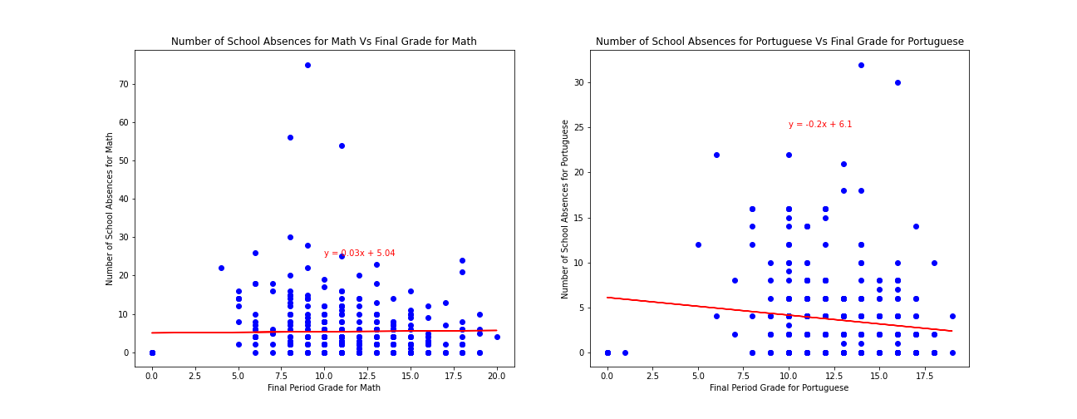
Scatter Plot depicting absenteeism rate vs Final Grade

Slide 17
Section 3
Socio-Economic Factors
Joshua Tean

Slide 18
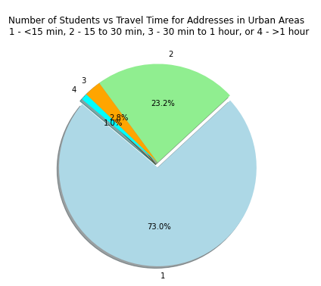
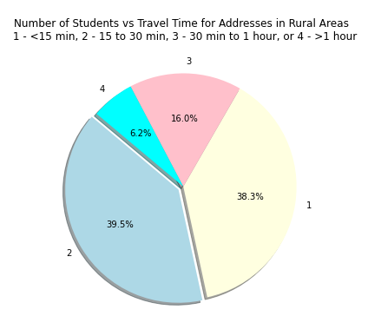
Pie Charts Showing Travel Times of Students in Urban & Rural Areas

Slide 19
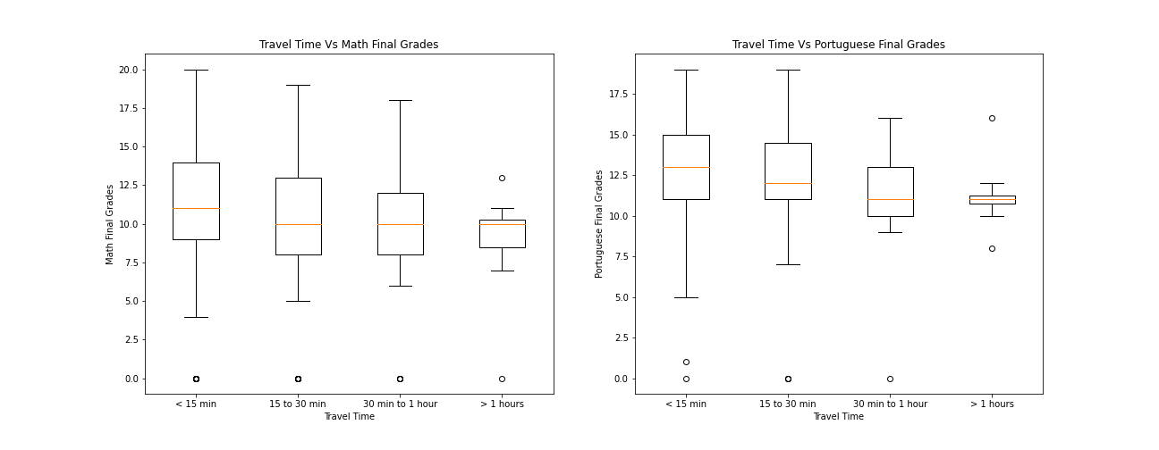
A box plot showing how travel time might be a contributing factor to students grades

Slide 20
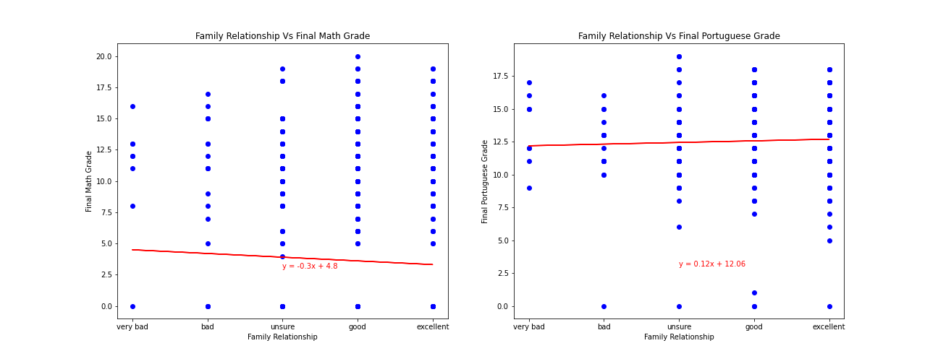

A Linear graph depicting how family relationship can contribute to students grades

Slide 21
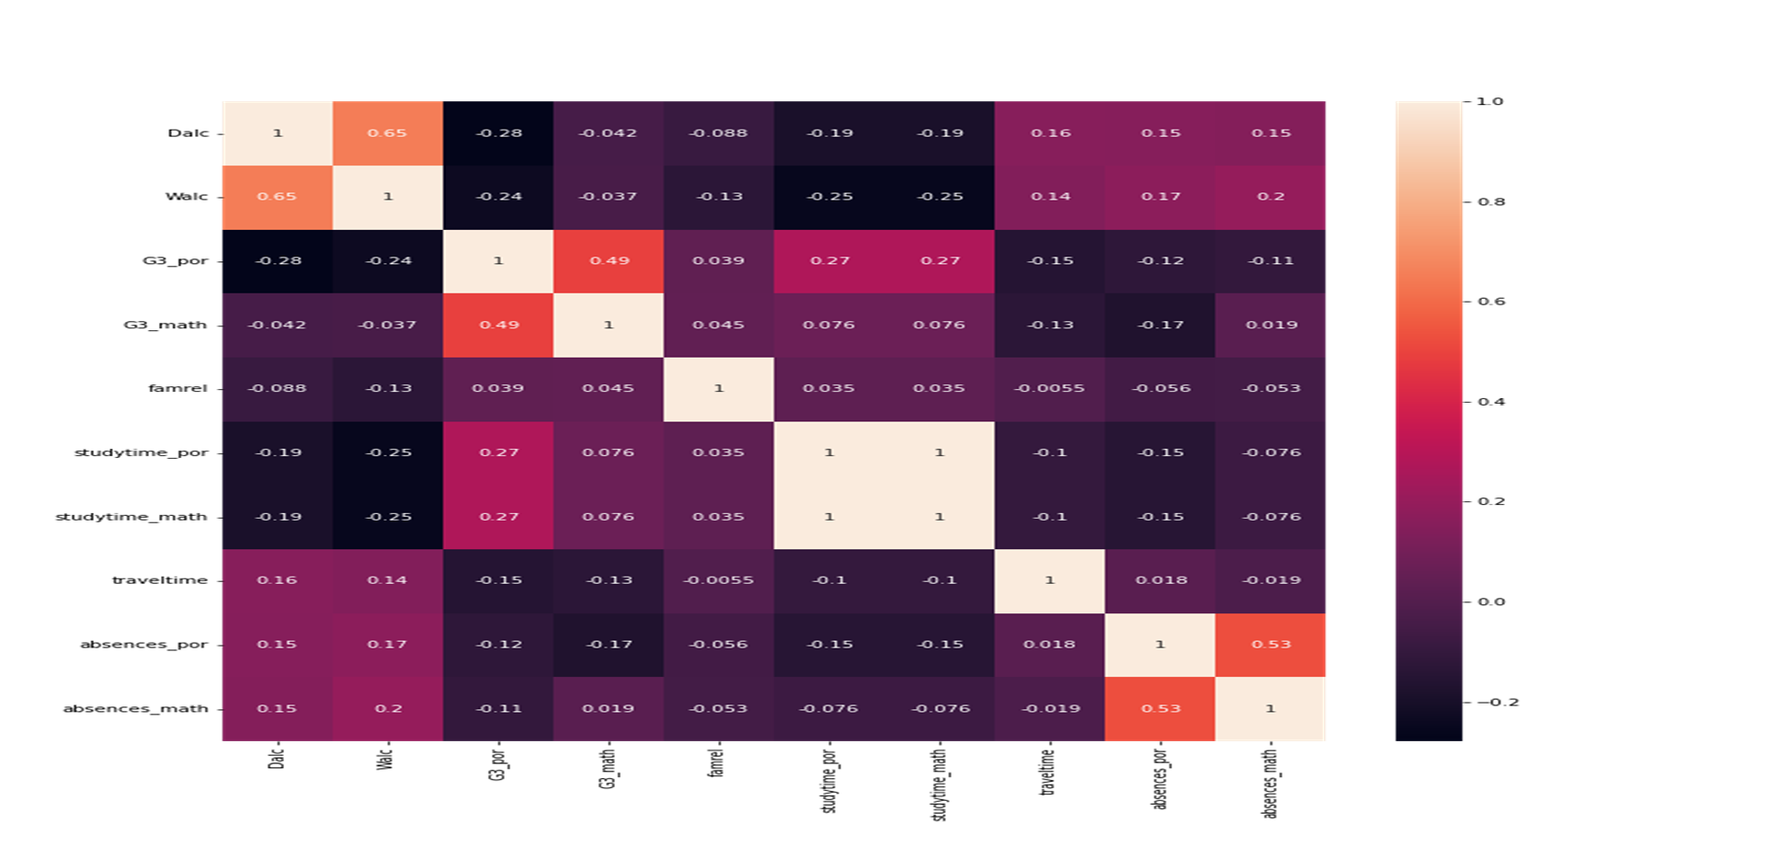
Heatmap showing a key determinant point in place that has a potential contributing factors to affecting student grades.

Slide 22
Statistical Significance of Study Time
Statistical Significance of Alcohol Consumption Habits
 | Statistic | Pvalue
Final Math Grades | 1.2268262651371196 | 0.299728941279215
Final Portuguese Grades | 12.211856898115895 | 1.2402988062865567e-07
 | Statistic | Pvalue
Weekday Consumption & Final Math | 1.113585395009432 | 0.3497837813433307
Weekday Consumption & Final Portuguese | 10.777988979046963 | 2.872537539647647e-08
Weekend Consumption & Final Math | 0.40021419738346875 | 0.808482036488183
Weekend Consumption & Final Portuguese | 5.68330528990033 | 0.00019026774756571534

Slide 23
Hypothesis
Study time has positive impact on final grades
Rejected for Math
Accepted for Portuguese
Alcohol consumption has negative impact on final grades
Rejected for Math
Accepted for Portuguese

Slide 24
Questions?

